Slide 1
Learn To Program JAVA
孙彩虹 信息学院
School of Information,RUC
Email: chsun@ruc.edu.cn
Office:理工配楼402A
Learn To Program Java

Slide 2
写在前面……
目标
  学会用Java编程
  学会面向对象思想
  学习Java设计模式
  学习Java多线程并发编程
  初步了解开发框架spring boot
    简化 Java 企业级应用的开发难度和开发周期
要求
  考勤（课上+上机） （5%）
  课后作业 基本上每周都有，大约10次。每次作业量在1-1.5小时 （15-20%），记8次作业成绩。
  大作业 自由分组 每组2-4人，自选题目 （25-30%）
  期末闭卷 （50%）
重要！自己写程序！可以借助工具，但要懂，有判断力。
更好地使用工具。
Learn To Program Java

Slide 3
教材和课程安排
可以不用指定教材(自选)
不完全按某本教材讲，主要参考如下教材
  Daniel Liang, JAVA语言程序设计基础篇+进阶篇
  Danny poo, Java Programming (入门级)
  Bruce Eckel, Thinking in Java (一些面向对象思想)
课程安排
  JAVA入门 （4次课）
  JAVA面向对象（4次课,包括简单GUI）
  JAVA 高级部分 （5次课）
  综合复习 1次课
Learn To Program Java

Slide 4

What is Java? The view of Software engineer
JSP/servlet
RMI/EJB
JAVA EE
Struts/WebWork
JAVA
Websphere
Middleware
WebLogic
Tomcat
DBMS
DB2
Oracle
OS
Windows
Linix/Unix
Learn To Program Java
Notes:
OS: platform for user, low layer
JAVA EE: programming
JAVA Basics keep constant

Slide 5
Hierarchy of Learning Java
JDK configuration
Variables & Data Type
Java
programming
Design Basics
operators,expressions,statement
Simple Java program
Loop&selecion
Arrays & Methods
Basic format of Class
Functions of Class
packages
Java
Object
Oriented
Inheritance
Exceptions
Abstract class& Interface
Multi threads
Networking
JAVA IO
Java
Advances
Java Application Programming
JAVA API
JDBC

Slide 6
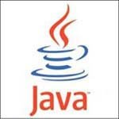
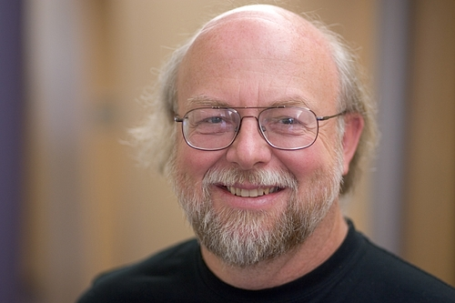
History of Java
a product of Sun
  Sun: Stanford University Network
  1982.2
1991 Oak embeded->HotJava
1995.5.23 Sun Java 1.0 (Java Development Kit JDK 1.0) James Gosling
1998 JDK1.2 ->Java 2
2005 rename J2SE,J2ME,J2EE->JAVA SE,JAVA ME,JAVA EE
2010 Oracle收购Sun

Slide 7
JSP/Servlet
JAVA EE
JAVA ME
CLDC,MIDP
EJB
Games
Services
Communications
…
…
Core
JAVA SE
Object Oriented
API
JVM
…
Learn To Program Java

Slide 8
What is java?
Programming language
  Grammar, semantic
Program development & runtime environment
  JDK( code & run)
  JRE (run): JVM+ runtime interpreter
  Oracle网站上下载安装
IDE
  Vscode；Cursor；IntelliJ IDEA
  ……

Slide 9
Design objects of JAVA
Object Oriented
  Smalltalk->C++
Platform independent, imigratation
Easy (compare with C++)
Robust: Garbage Collector, JVM
multithread
Code checker: security
Learn To Program Java

Slide 10

Chapter 01
Computer Programming
Learn To Program Java

Slide 11
环境变量
Path，修改 java.exe所在路径加上去
Classpath .;
Java_home
这些主要在windows下配置，windows的环境变量名不区分大小写
理解这些环境变量的含义
特别注意classpath里面要加”.”表示当前工作目录
Learn To Program Java

Slide 12
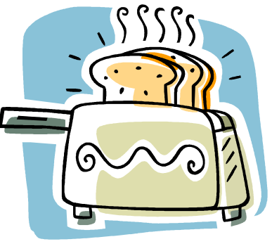
Programs
Instructions to computers, much like recipes are instructions to a budding cook on how to prepare a meal.
Programs are written with a programming language.
Execution of programs is carried out one statement at a time and one after another.
Learn To Program Java

Slide 13
What is Java?
Full-fledged, high-level, general purpose programming language.
Java is now more than a programming language. It has evolved into a programming platform:
  J2EE (Java 2 Enterprise Edition)
  J2SE (Java 2 Standard Edition)
  J2ME (Java 2 Micro Edition)
Java programs are platform independent.
Java is object oriented (Reusable).
Learn To Program Java

Slide 14

High-level vs. Machine Language
High-level Language
  Easily readable by humans. Example: (a + b) * c
  Used to write most computer software.
  Cannot be directly understood by a computer.
Machine Language
  The language understood by the CPU.
  Object code.
Learn To Program Java

Slide 15
What is java? Three main mechanisms
Java Virtual Machine (JVM)
Garbage collection
Code Security

Slide 16
Language Translators
Compiled Programs
  Program (source code) translated into object code that a machine understands.
  Done via the use of a compiler.
  An object code is tied to the machine architecture.
Interpreted Programs
  Programs need not be translated into object code before execution.
  Does not produce any intermediate object code.
  Done via the use of a interpreter.
Java uses interpretation and compilation. Why?
Learn To Program Java

Slide 17
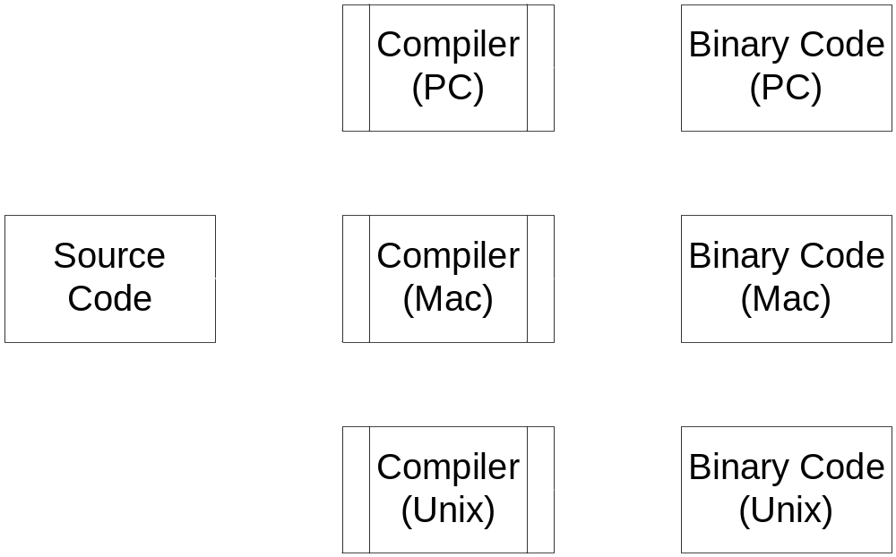
Java platform independent
Traditional Languages (e.g. C, Pascal)
Learn To Program Java

Slide 18
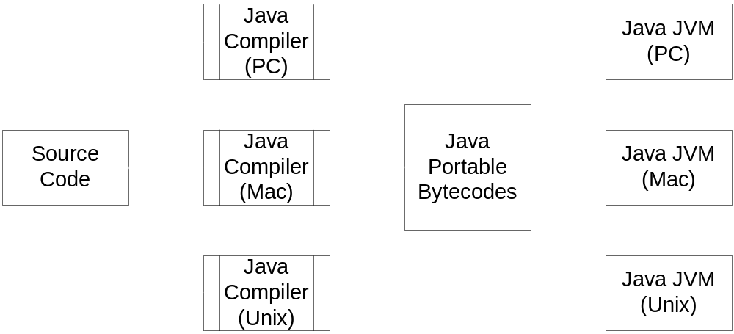
Java platform independent
Java Programming Language
Learn To Program Java

Slide 19
Structure of a Java Program
A program that prints a line: "How do you do?"
Classname reflects what the code is about.
Convention, capitalize the first letter of the class name
class HowDoYouDo {
public static void main (String args[]) {
System.out.println(“How do you do?”);
}
}
A class is a grouping of components in Java. A class groups data attributes and methods.
More details of classes in Chapter 6.
A method is a grouping of statements that when called will execute statement by statement until the last statement is completed.
The main method will be called when we execute the program.
More details of method in chapter 5
Learn To Program Java

Slide 20
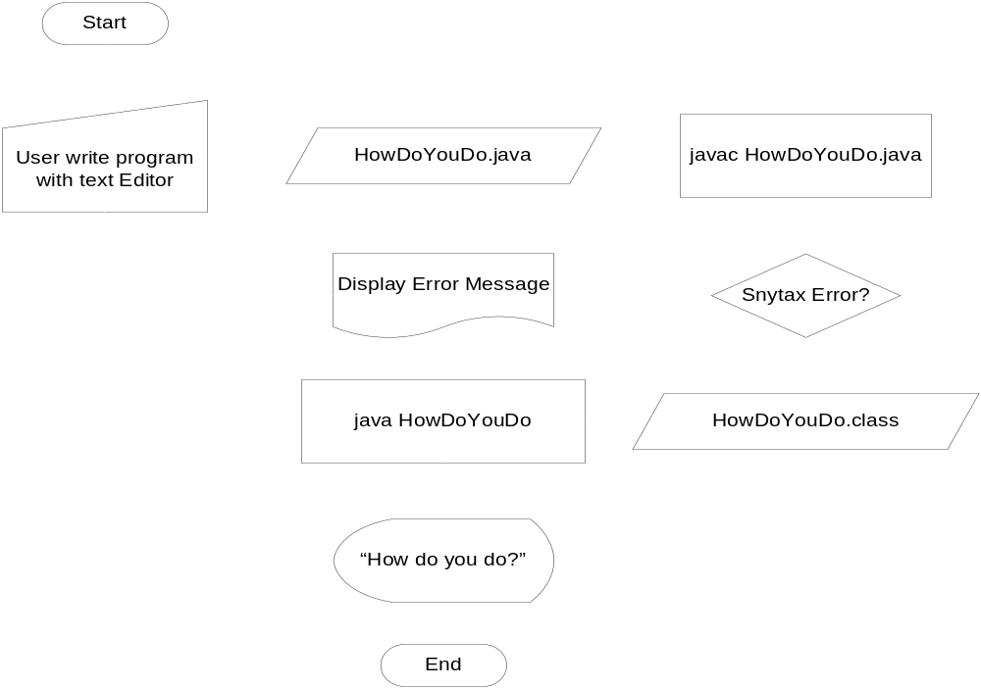
Compiling and Executing a Java Program
Learn To Program Java

Slide 21
Types of Errors
Syntax Errors (Grammar)
  Syntax is the set of rules that determines whether a particular statement is correctly formulated.
  Syntax rules must be followed.
  The java compiler catches syntactic errors, producing error messages.
Semantics Errors (Logic)
  Semantics refers to the meaning (effect on the program) of each Java statement.
  The programmer must test thoroughly for semantic errors.
Learn To Program Java

Slide 22
Locate the Syntax and Semantic error.
Program is supposed to print 5 asterisks.
Semantic error, there should be 5 asterisks.
class PrintAsterisks {
public static void main (String args[]) {
System.out.println(“**”)
}
;
}
Syntax errors: Missing “;” at end of statement and missing “}” for main method
Learn To Program Java

Slide 23
Java Runtime Environment
Java Runtime Environment
  JRE= JVM+ Runtime Interpreter
Three functions of JRE
  Class loader
  Byte code verifier
  Runtime interpreter

Slide 24
Preparing to run a java program
Install JAVA SDK
  Download SDK www.oracle.com/technetwork/java/javase/downloads.index.html (demo)
  OS -- 32bits/ 64bits 别下错了)
  Install SDK
  Environment Variables （windows环境下配置）
    path
    classpath
A simple example

Slide 25
IDE
Vscode：Extension Pack for Java
cursor ：导入Java项目，会提示安装一些Java扩展。
IntelliJ IDEA
Eclipse
NetBeans
……
Learn To Program Java

Slide 26
Programming Objectives
A program is written for the purpose of problem solving using computers. It represents the solution to the problem that it attempts to solve.
Efficiency
Correctness
Clarity
Learn To Program Java

Slide 27
Clarity
Separate contents into logical units.
Make a careful choice of data structures and language components.
Use comments to explain your code.
Use blank lines and indentation.
Clarity
Learn To Program Java

Slide 28
Correctness
Usefulness of a software program is measured by its correctness to its specification.
Choose the simplest algorithm or method to write programs.
Correctness
Learn To Program Java

Slide 29
Efficiency
Minimize the number of operations a computer processor has to execute on a program.
Consider the data used and the number of operations to minimize the usage of computer memory.
Efficiency
Learn To Program Java

Slide 30
Hello world Example
A program that prints a line: “Hello World!!"
Classname reflects what the code is about.
Convention, capitalize the first letter of the class name
public class HelloWorld {
public static void main (String args[]) {
System.out.println(“Hello World!!”);
}
}
A class is a grouping of components in Java. A class groups data attributes and methods.
More details of classes in Chapter 6.
A method is a grouping of statements that when called will execute statement by statement until the last statement is completed.
The main method will be called when we execute the program.
More details of method in chapter 5
Learn To Program Java

Slide 31
Summary
Introduction to Java
Program is a set of instructions to computers.
Java is a full-fledged, high-level, general purpose programming language.
Java uses both interpretation and compilation.
Types of Errors: syntax and semantic.
Configuration of JAVA
Programming Objectives: clarity, correctness and efficiency.
Learn To Program Java

